Slide 1
Museums as a community resource: Citizens empowerment, social inclusion, and wellbeing
Pier Luigi Sacco
FBK-IRVAPP Trento
Harvard University
IULM University Milan
European Commission

Slide 2
The Culture 3.0 paradigm
Culture 1.0 (Patronage): Highbrow vs. lowbrow, culture as spiritual cultivation, no industrial organization
Culture 2.0 (CCIs): copyright, culture as entertainment, market organization
Culture 3.0 (open communities of practice): blurred distinction producers/users, culture as collective sense-making, networks organization

Slide 3
Three different regimes of cultural value creation
Culture 1.0: patronage.
No industrial organization
Subsidies indispensable
Centered on creative development & expert recognition
Select audiences
Highbrow/lowbrow
Culture 2.0: cultural and creative industries
Industrially organized
Profitable
Centered on market outcomes
Large audiences
Copyright
Culture 3.0: open platforms
Commercial platforms + communities
Profits + crowdfunding
Centered on co-creation
Prosumer ecosystems
Virality

Slide 4
Mapping cultural and creative sectors The non industrial core (1.0)
Visual arts
Performing arts
Heritage and museums
They are like the ‘R&D’ lab of cultural and creative production
Cannot sustain themselves on the market, but are a crucial dynamic force
They are tendentially elitarian, but must be made as inclusive as possible

Slide 5
Mapping cultural and creative sectors Cultural industries (2.0)
Publishing
Cinema
Music
Radio-television
Videogames
‘Experience economy’ industrial sectors based on the ‘first wave’ of cultural technical innovation (except videogames)
More elitarian in Europe, more mass-market in the US and Asia
The cornerstone of industrial cultural production

Slide 6
Mapping cultural and creative sectors Creative industries (2.0)
Design
Fashion
Industry of taste
Communication & advertising
Architectural design
Serious gaming
At the crossroads between cultural and functional content
Strong segmentation, from luxury high end to mass market
The most dynamic component of the industrial spectrum

Slide 7
Mapping cultural and creative sectors: Open platforms (3.0)
Collaborative ecologies (Wikipedia)
Blogs and ground publishing
Content communities (YouTube, Instagram)
Social networks (Facebook, Twitter)
Filter communities (Reddit, Imgur)
Personal broadcasting (Snapchat, Whatsapp)
Virtual social worlds (Second Life)
Game worlds (World of Warcraft)
Mostly user content-driven, but very effective for traditional cultural and creative players
Complex mix of market and non-market element, profitable data ecologies
A mutable space in perpetual evolution and difficult to chart, which increasingly interacts with traditional sectors

Slide 8
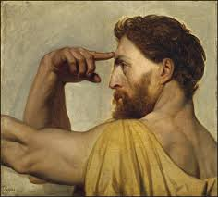
The 0-1 transition
The artist as an independent figure is increasingly recognized although craftmanship and artistry are still blended
The notion of authorship marks a discontinuity with grassroots culture and circumscribes the making of culture as a creative act with its own rules
Culture can be commissioned as an individual act of will
Culture relates to personal cultivation and not only to religious or civic rites
Culture associates with an idea of ‘good life’ and with disposable luxury

Slide 9
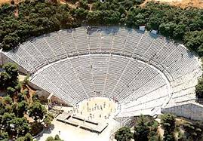
Culture 0.3: proto-patronage
In Greek city-states, culture becomes an element of social debate and even critique
Commissioning is supported by forced taxation of the richest citizens
The social role of the creators becomes more recognized and their names transmitted
The notion of ‘audience’ as people intentionally participating to a cultural event takes shape

Slide 10
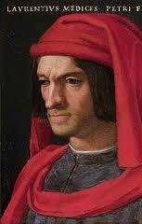
Culture 1.0: patronage
The pre-industrial regime: no possibility of organized markets; culture does not produce major economic value added but absorbs it; small, elite audiences that gradually expand as more sophisticated sub-regimes emerge
Initially founded on the virtue of parsimonia: emphasis on human cultivation and balance
Classical patronage
Strategic patronage
Public patronage
Committed patronage
Civic patronage
Entrepreneurial patronage

Slide 11
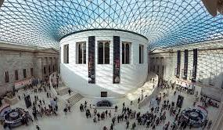
Museums 1.0: temples of knowledge
In the patronage regime, the museum is mainly focused upon the conservation, development and presentation of its collections
The creation of value is connected to the strengthening and cultivation of the museum audience, and to the transfer of knowledge and competences that this implies
Economic sustainability concerns are seen as an interference with the pursuit of the mission of the museum, and the very goal of patronage is that of freeing the museum from the pursuit of activities that are extraneous to its educational mandate

Slide 12
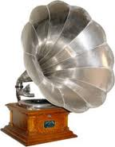
The 1.0-2.0 transition
Modern cultural markets are created by the concurrent emergence of a wave of technological innovation at the edge between XIX and XX century: modern printing, radio, music recording, photography, cinema
The fact that for more than one century through the industrial revolution culture is not industrialized, however, creates a permanent frame of mind in Europe according to which culture is un-economical and needs to be subsidized anyway
The high-brow stigma of patronage makes commercialization of culture problematic to many cultural players and to part of the audiences

Slide 13
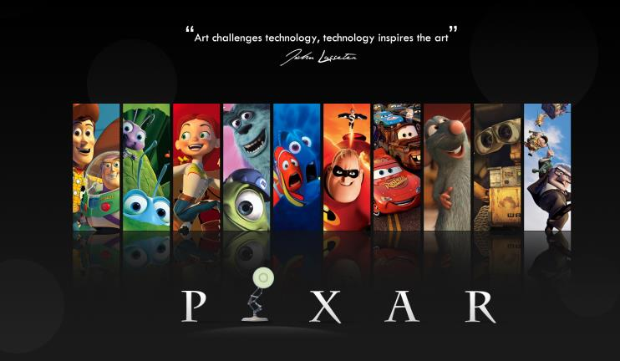
Culture 2.0: cultural and creative industries
With the massive urbanization that follows the industrial revolution, and with the ‘cultural’ industrial revolution that happens at the turn of the XX century, cultural markets can finally emerge
The industrialized forms of culture become profitable, the size of the audience expands dramatically, and culture becomes increasingly linked to entertainment
Emphasis on profitability and audience response:
Proto-industry
Mainstream
Counter-mainstream
Subcultures
Fan ecologies

Slide 14
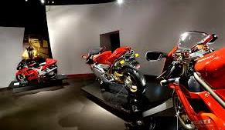
Museums 2.0: entertainment machines
Although the museum cannot be properly ‘industrialized’, there is an increasing expectation that the museum is generating income, is managed efficiently, and contributes to the development of the tourism industry
Economic returns are not seen as an interference in the pursuit of the museum’s mission
Audience response increasingly becomes an explicit success factor and significantly constraints the museum strategies and policies
The museum environment itself performs a spectacular function

Slide 15
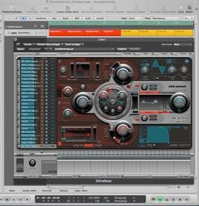
The 2.0-3.0 transition
We are now witnessing a new regime transition that is driven by two concurrent streams of innovation: digital content production + digital connectivity
Standard digital suites provide people with semi-professional packages that are cheap and easy to learn; with a modest investment they can be upgraded at the professional level
The same packages less than 2 decades ago would have been expensive, would have required bulky hardware and would have been difficult to use
Contents can be distributed almost without mediators to highly segmented and profiled audiences by means of increasingly specialized social media

Slide 16
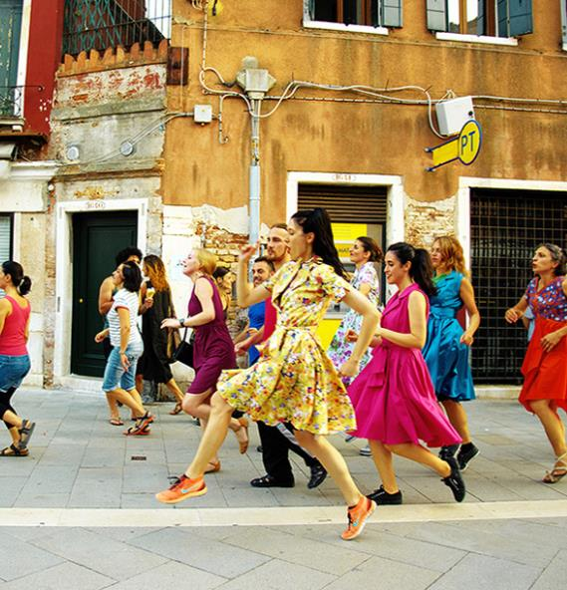
Culture 3.0: content communities
Collapse of the separation between producers and audience: a blurred continuum of active/passive participation
A new wave of technological innovation that enables massive, shared and shareable production of content and instant diffusion and circulation
The production of value moves to the social domain and connects to all of the main dimensions of civic functioning: innovation, welfare, sustainability, social cohesion, lifelong learning, social entrepreneurship, local identity, soft power

Slide 17
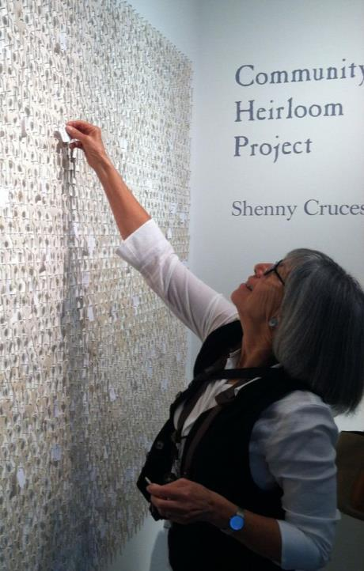
Museums 3.0: participative platforms
The idea of a passive audience is gradually substituted by a spectrum of forms of direct engagement
Museums can create value in terms of innovation hubs, welfare hotspots, sustainability facilitators, social cohesion gateways, etcetera
The new forms of value entail different forms of social interaction and exchange as constituent factors
The museum opens its collections to the possibility of creative appropriation and remix of its contents by users

Slide 18
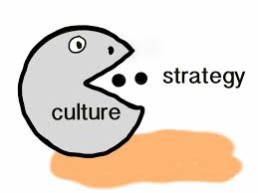
The culturalization of the economy
Ubiquitous and increasingly active participation brings cultural production into the very fabric of everyday life of everybody
Culture becomes a key asset at the top of any kind of value chain
Capacity to unleash the potential of culture as a source of value is a key factor of competitiveness and smart growth
But the point is: will we be able to make cultural platforms inclusive or will we make of culture another channel of income and opportunity inequality?

Slide 19
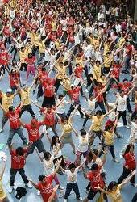
The evolution of participation
Culture 1.0: participation as co-optation (limited, passive)
Culture 2.0: participation as market access (generalized, passive)
Culture 3.0: participation as community affiliation (generalized, active)
We need a conceptual scheme that allows us to understand (and capitalize) the socio-economic effects of cultural participation
The new paradigms of cultural production do not necessarily use the market as the value-generating platform (communities of practice)

Slide 20
Shifting emphasis

Slide 21
A transition under way

Slide 22
The museum spectrum: Combinations of value creation channels

Slide 23
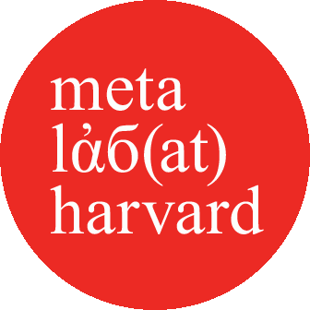
Eight types of museums
Auratic museum environments | High visitor and social attendance | “Gold Standard” (GS)
 | High visitor, low social attendance | “Ivory Tower” (IT)
 | Low visitor, high social attendance | “Midcult Theme Park” (MTP)
 | Low visitor, low social attendance | “One Shot Mecca” (OSM)
Non-auratic museum environments | High visitor and social attendance | “Learning Center” (LC)
 | High visitor, low social attendance | “Geek Temple” (GT)
 | Low visitor, high social attendance | “Access Gateway” (AG)
 | Low visitor, low social attendance | “Open Classroom” (OC)

Slide 24
Museums as places of well-being
Sense of purpose
Sense of belonging
Cognition
Affect
Agora
Stage
School
Home

Slide 25
An 8-tiers approach to the indirect effects of cultural participation
Innovation
Health & wellbeing
Sustainability
Social cohesion
New entrepreneurship
Soft power
Local identity
Lifelong learning

Slide 26
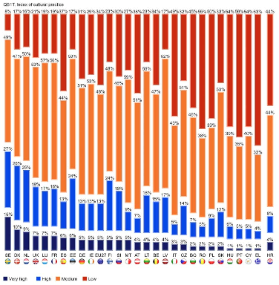
Culture-innovation clusters
Top innovation + culture: Sweden, Denmark, Netherlands, UK, Ireland, Luxembourg, France, Germany
Top innovation + culture lagging: Finland, Belgium, Austria
Top culture + innovation lagging: Spain, Estonia
Lagging innovation + culture: Slovenia, Malta, Croatia, Italy, Czech Republic
Bottom innovation + lagging culture: Lithuania, Latvia, Bulgaria, Romania, Poland
Bottom culture + lagging innovation: Cyprus, Portugal, Greece, Slovakia, Hungary

Slide 27
Hierarchy of factors affecting psychological well-being

Slide 28
Hierarchy of factors affecting psychological well-being
1 Diseases
2 Cultural participation
3 Income
4 Age
5 Education
6 Gender
7 Job
8 Geography

Slide 29
Classical music concerts

Slide 30
Theatre

Slide 31
Which single variables have the strongest impact on SWB?

Slide 32
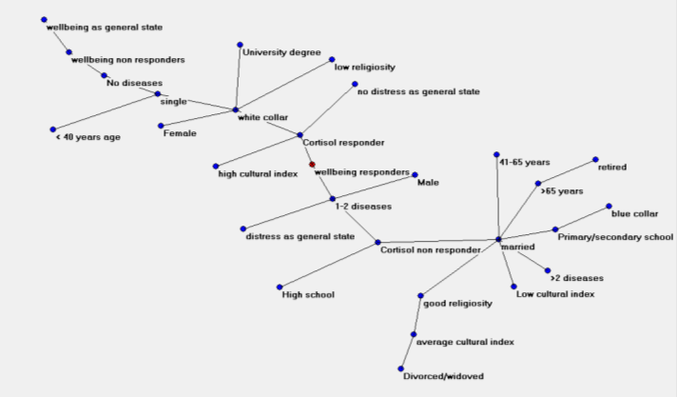
More than you know (or imagine)

Slide 33
Implications
There is not a ‘right’ rule to value creation
Every museum must find its own proper mix of value creation channels depending on its characteristics, mandate, context, and constraints
The museum value creation philosophy needs to be clearly spelled, communicated, and accounted for: the crucial role of measurement
The value creation philosophy is to be read in the framework of the local cultural and creative ecology
Avoid being judged against an inappropriate benchmark!

